Slide 1
Team Asclepius
Insight into New Zealand economics - A data science approach

Slide 2
Overview

Slide 3
What do we want to collect
Historical economical activity data for New Zeland
Economical policy data of New Zealand Government

Slide 4
Why do we choose these data sources
To build a solid fundation for further data analysis
To find correlation between these data

Slide 5
What target you chose (I.e.n what is the intended use of the data, …)

Slide 6
What difficulties you have to overcome to wrangle the data sources into the target data model

Slide 7
What techniques you did see

Slide 8
What you managed to achieve and what you failed to do

Slide 9
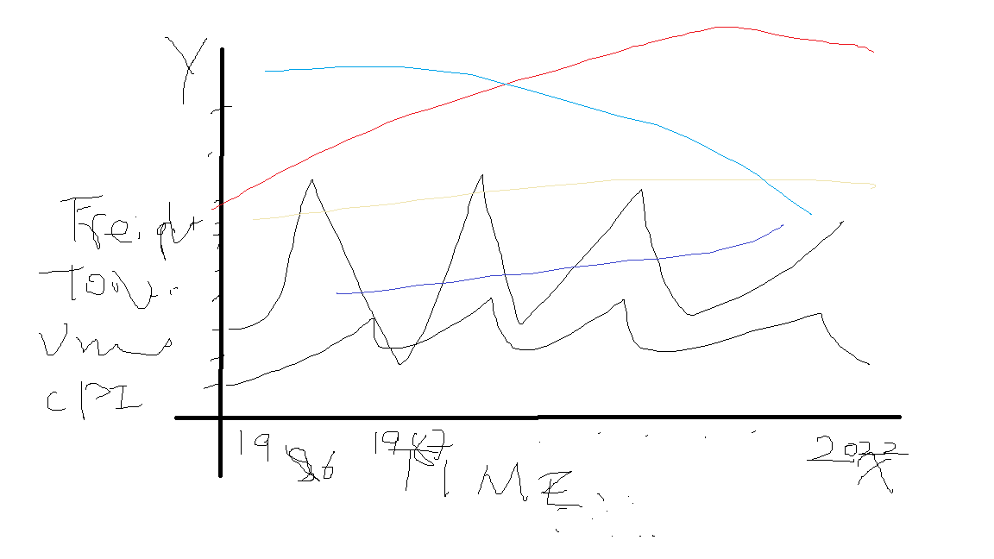
Charts generated to

Slide 10
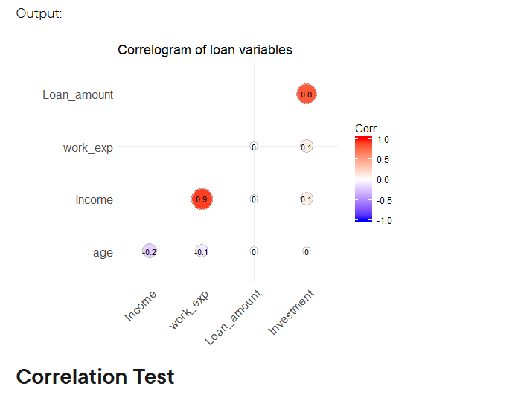
Charts Generated

Slide 11
Conclusions
Based on the data we have collected as well as what subsequent plots generated based on that. The following insights have been reviewed.
As New Zealand Reserve Bank sets its interest rate up, various business will have difficult of getting cheap loans for further development, therefore business activities have been reduced, which leads to increase of unemployment.
On the other hand, increase of Reserve Bank interest rate will attract oversea hot money for short term investment, therefore it is anticipated that exchange rate of New Zealand dollars VS. Other currency will go up. The high Reserve bank interest rate will lead to lower level of economic activities, hence in term of cargo freight statistics, general vehicle activities and tourism account, we are anticipating dropping in these activities.
However, Reserve Bank raise interest rate usually to combat high inflation rate (CPI), therefore, we should be expecting dropping of the CPI.

Slide 12
When the economic activities are low and unemployment rate is high
New Zealand government is under pressure to unleash new monetary policies to stimulate economy. Hence government usually resolve to lower reserve bank interest rate.
With high reserve bank interest rate, we should be able to observe weak New Zealand dollars VS other currency. Thus make export of our products cheaper, therefore attracts more oversea orders, subsequently we should be able to observe an increase of freight transportation activities, oversea passage flights.
To stimulate general economic growth, government usually starts major infrastructural projects like major road works, etc. Hence it is also anticipated that general road construction activities are increasing.

